Slide 1
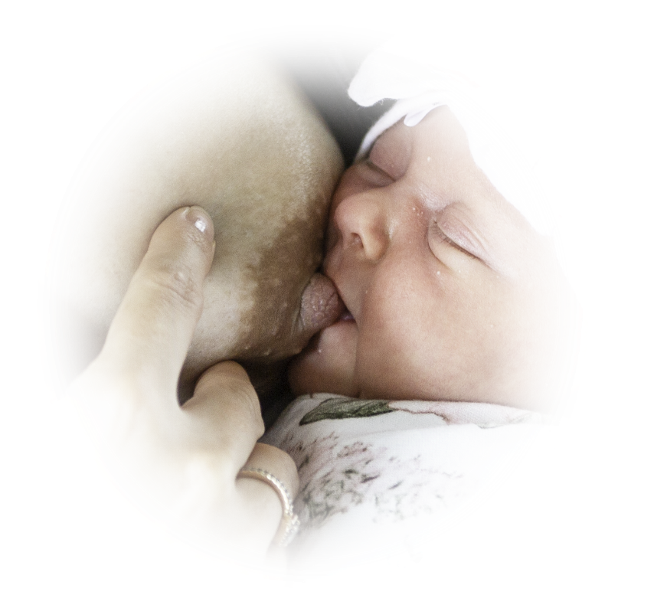
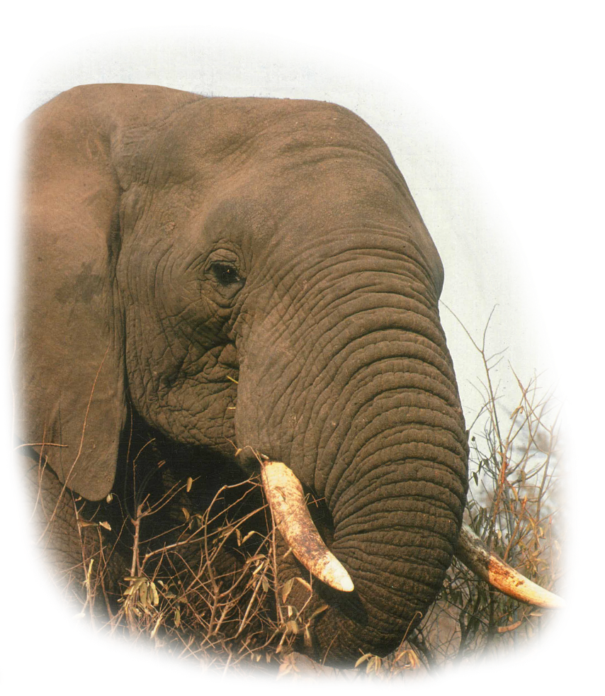
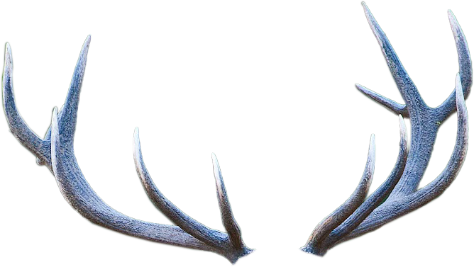
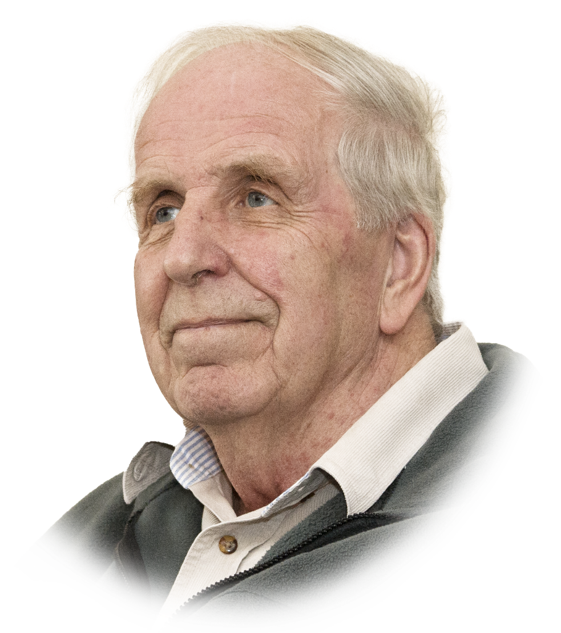
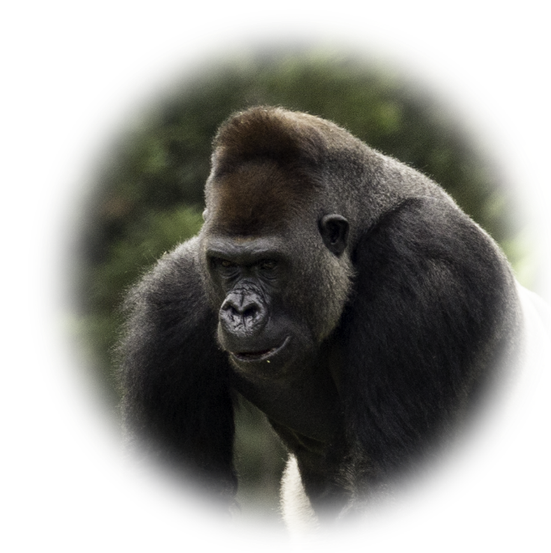
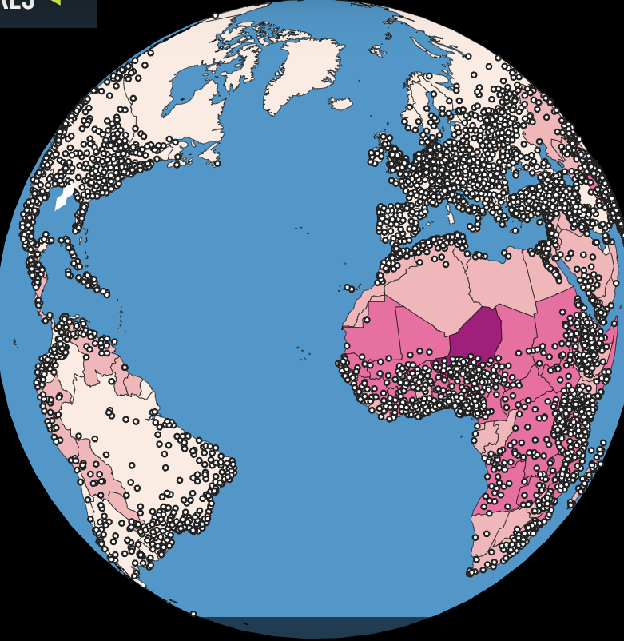
Roger V Short
Roger V Short was an inspirational reproductive biologist. His depth of insight into so many aspects of reproductive biology research was truly astonishing. He was a hugely supportive of early career researchers.
Notes:
SRB, SRF, SSR and Drs. Marilyn Renfree and Jock Findley.
Described as monumental 19th century thinkers of science, Great Man of Science – breadth and depth.

Slide 2
Roger V Short and his Science
Diapause badger blastocysts – Pearls of life!
Breastfeeding/lactation and Contraception
Sexual differentiation in spotted hyena, the elephant and the tammar wallaby
Hybridization of Old and New World Camels
Elephant’s intra-abdominal testes
Progesterone in uterine blood during pregnancy
Sperm immobilizing properties of lemon juice
Inter- and extra-species pregnancies in equids
Hormone control of sexual dimorphism in birds
Ovulation in prenatally androgenized ewes
Sexual differentiation of the brain of sheep
World population growth and future fertility
Male circumcision and HIV
Hormonal influences on
tumor growth
Triplets in mares
Sexual selection in Great Apes
Sexual behaviour in Red deer
Red Fox fertility
Notes:
Trevor G Cooper, David J Handelsman“focused on the largest themes of reproductive biology in its widest latitude”.
Emerson – “explore truth and beauty, be bold, be firm, be true…hold yourself fast by the intellect….Explore. Explore.”

Slide 3
Roger V Short Medal and Lectureship
This prestigious international award is designed to recognize early career researchers who possess the same spirit of discovery, creativity, and imagination as Roger V Short, and who have made outstanding discoveries in the field of reproductive science.
Roger V Short, Fellow of the Royal Society, and illustrations representing some of the diversity of his research interests.
Notes:
Mention 3rd competition

Slide 4
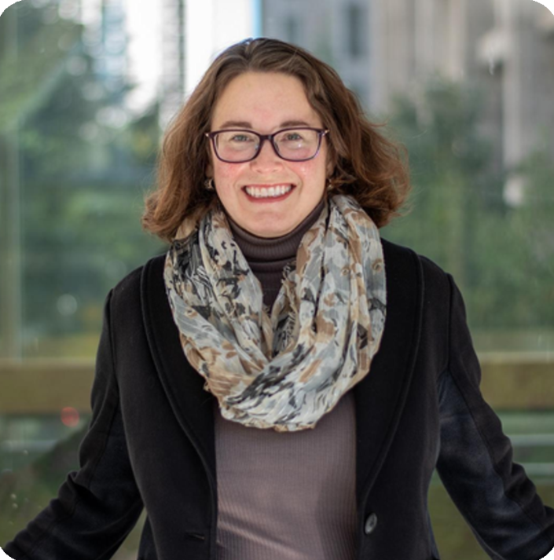
A Decade of Discovery:
Ovarian Aging from Mechanisms to Clinical Translation
Francesca E Duncan, PhD
Associate Professor, Obstetrics and Gynecology
Thomas J Watkins Memorial Professor in Reproductive Science
Co-Director, Center for Reproductive Science, Feinberg School of Medicine, Northwestern University
Chicago, IL
Notes:
PhD in Cell and Molecular Biology from the University of Pennsylvania with Dr. Carmen Williams.
Her first postdoctoral fellowship at the University of Pennsylvania with Dr. Richard Schultz with a 2nd pdf with Dr. Teresa Woodruff at Northwestern
Established an independent research program as an Assistant Professor at the University of Kansas Medical Center
Returned to Northwestern as Assistant and now Associate Professor in the Department of Obstetrics and Gynecology, ….

Slide 5
In case background colors change on your computer – next slides show color selection

